Slide 1
Migration-aware Network Services with Edge Computing
Presented by
Sreyashi Mukherjee

Slide 2
What is Edge Computing
Is a distributed computing paradigm that brings computation and data storage closer to the sources of data.
Improves response time
Saves bandwidth

Slide 3
Internet of Things
Describes the network of physical objects – “things” that are embedded with sensors, softwares and other technologies for the purpose of communication with other devices.

Slide 4
Abstract
MEC(multi access edge computing) has resulted from supporting next generation mobile services which need high capacity, high reliability and low latency. In this paper we focus on minimization of migration events rather than maximization of resource usage. We have used priority induced service migration minimization(PrISMM)algorithm which minimizes service migration for both high and low priority services.

Slide 5
Introduction
The idea of MEC servers situated close to the end users was materialised in order to process computations and store cached content on behalf of mobile devices. Proximity between the user and server helps in lowering the delay of communication. Thus MEC is an improvement over cloud computing.

Slide 6
A. Motivation
Service migration is triggered in two conditions-
mobility
Providing a single MEC Server is not sufficient when users are mobile. So they are placed at several locations. A “hand-over” mechanism takes place which is termed as service-migration.
when users with different priority are served by the same set of MEC Servers.

Slide 7
Continued…
Drawbacks-
Service might be temporarily stopped.
Network links flooded with huge volumes of data.
Hence our objective should be to minimize number of service migrations of mobile users.

Slide 8
B. Contributions
We consider two kinds of users- high priority mobile users and low priority static users.
We also consider two very important modern day use cases- mobile ambulance(MA) and opera house(OH) users.

Slide 9
Contributions continued…
PON(Passive optical network)- provides connectivity among MEC Servers.
MDP(Markov Decision Process)- We use MDP for high priority MA users using the already available knowledge about the destination hospital of the MA
LA(learning automata)- reserves sufficient resources for MA users.
GAP(generalized assignment program)- done for low priority OH users.

Slide 10
Related Work
Majority of work focused on the cost of service migration and the QoS enhancement achieved after carrying out the migration procedure. Such problem has been solved with MDP.
Some of the works were based on the following-
One-dimensional MDP
Two-dimensional MDP
Look-ahead time window
Follow me edge
Lyapunov optimization

Slide 11
System Model
Backhaul Network
A group of MEC Servers form a MEC system.MEC servers are placed in the macro BS. Multiple PON’s emantating from a controller provides connection to a network of MEC servers where the controller node is located at the center of the city. The controller is responsible for providing allocation information to all MEC servers. It also supervises the service migrations.

Slide 12
User traffic model and user location
MA users have average arrival rate of λ_{MA}
Users/sec and average holding time of H_{MA} sec.
OH users have average arrival rate of λ_{OH}
Users/sec and average holding time of H_{OH} sec.
To determine the group size of OH users we use Poisson mean of Λ_{OH}
The location of both the users are chosen randomly in the map by uniform distribution.

Slide 13
Servers
All the servers have equal capabilities in all their processing units so one is preferred over the other.
Transmission latencies
On arrival of new service request we identify the background traffic load on the PON and based on that we determine average transmission delay in the PON uplink.

Slide 14
If there is direct connection between the MEC server and the connecting macro BS then there is no delay otherwise then connection path must traverse through the controller node. As a result it suffers from delay.
Service migration messages
PON control messages like GRANT,REPORT are exchanged between MEC servers and the controller while performing service migration.

Slide 15
Priority induced service migration minimization(PrISMM)
Objective- To minimize mobility based migration.
Once we identify the suitable MEC server for executing the service requests from the MA users, we can proceed with the allocation of low priority OH users in such a way that enough MEC server resources are reserved for MA users.
We employ LA to determine precise quantity of server resource that need to be reserved for the MA users depending upon the load imposed.

Slide 16
Markov decision process based Allocation of the MA users
MDP is a optimization technique used for allocation of the MA users. Allocation of one MDP user is independent of another MA user. We design the rewards for the MDP by including the service migration penalty. Thus we can choose the MEC servers that may reduce the mobility based service migration of the MA users so that migration of lower priority services are reduced.

Slide 17
MDP Process
Inputs
States
Actions –
From initialisation state
From termination state
From any other state
Rewards
Transition probability
Solving the MDP

Slide 18
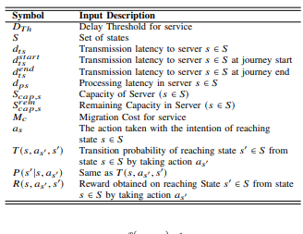
Notations used in MDP

Slide 19
3 termination criteria
MA user cannot be accommodated in the system, then process directly moves from initialisation state to termination state.
Migrated MA user may not be accommodated and servicing MEC server no longer satisfies delay criteria.
MA user has reached its destination.

Slide 20
3 reward calculation criteria
Delay requirement of a MA user can be satisfied by MEC server both at MA users current and final position.
MEC server can satisfy delay requirement of the MA user at the MA users current but not final destination.
MEC server cannot satisfy delay requirements at the MA users current location.

Slide 21
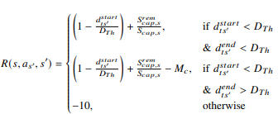
Rewards expressed mathematically

Slide 22
Explanation
Case 1:- If the migrated server is able to serve both the current location and destination location of the user. In that case there is no need for extra migration.
Case2:- The new server is not able to serve the MA user at its destination hospital but is able to serve at its current location as it is not below the acceptable threshold latency.
Case3:- The new server cannot serve either at the current or destination location of the MA user.

Slide 23

Solving the MDP – Value iteration
The optimum solution of the MDP is evaluated using the Bellman equation as follows-

Slide 24
LA based virtual capacity determination
The actions taken by LA is equated to the virtual capacities C_{j}.
LA can be independently executed in each MEC server.
The objective of LA is to find the optimum action that needs to be taken when learning entity is in a particular state.
Minimizing priority induced service migration of the lower priority OH users and lowering admission time of the higher priority MA users.

Slide 25
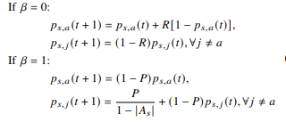
Probability updates

Slide 26

Calculation of rewards

Slide 27
Penalty calculation
Where ‘a’ is the last virtual capacity and C_{act} is the service capacity of the server. The min value of P is – C_{act} and max value is 0.

Slide 28
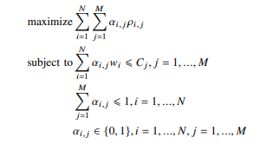
GAP based allocation of the lower priority services

Slide 29
Simulation setup
The environment was developed using OMNet++ network simulator.
The average arrival rate and average holding time for the OH users were fixed.
Though the average holding time of MA users were fixed but avg arrival time was varied.
Positions of the MEC servers were fixed for the entire simulation study.
Central node was placed approximately at the center of the city.

Slide 30
PrISMM performance evaluation
Average number of relocations per user
Overall drop ratio of OH users
Mean admission delay for the MA users
Overall drop ratio of MA users
Average number of relocations per MA use Radio Handover.

Slide 31
Baseline cases
Never-Migrate
Always –Migrate
PrISMM-noMDP
Only-MDP

Slide 32
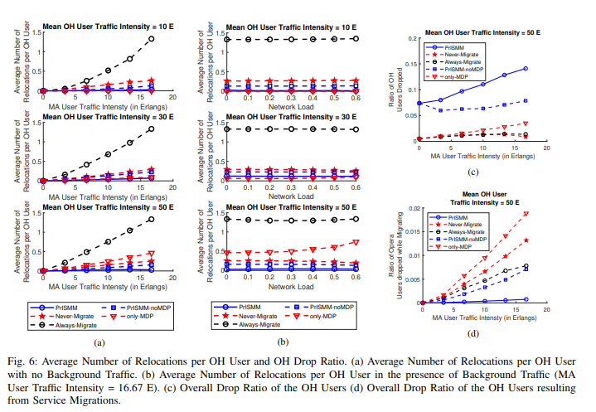
Results

Slide 33
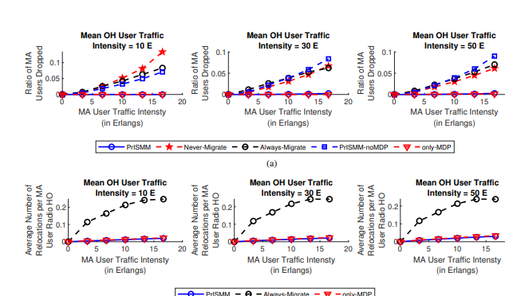

Slide 34
Observations
PrISMM reduces the average number of service migrations of lower priority OH users. PrISMM reserves MEC server units for the MA users.
For Always-Migrate scenario it results in highest number of OH user realocation.
PrISMM-noMDP does not support MA user service migration and reserves resources for MA users while allocating the OH user.
PrIsMM performs better than other algorithms in variable network loads.
Lowers admission time of high priority service into the MEC server.

Slide 35
Never-Migrate and PrISMM-noMDP lead to high MA user drop.
Always-Migrate suffers from highest number of mobility based realocations of MA users.

Slide 36
Summary
Process 1- There is an MDP per user determining which user will be allocated to which server and when in mobile state where it should migrate. This MDP only runs for high priority users.
Process 2- The number of high priority user and low priority user per server is determined by LA. So here we learn the probabilities of each action and accordingly increase or decrease the reward in the next iteration.
Process 3- Low priority users should be allocated to their nearest server using ILP.

Slide 37
Conclusion
MEC helps in offloading of processing tasks to nodes located close to end users in order to support high reliability, high capacity and low latency applications. Here we focused on minimizaton of migrations when services with different priorities appear. PrISMM reduces the cost considerably. It also reduces the admission time of high priority users and drop percentage for the new incoming users.

